Slide 1
SCRUM Presentation
Richard Deleon, Amanda Homeyer, Niraj Bhakta, Sarai Camargo, McKay Wilkerson

Slide 2
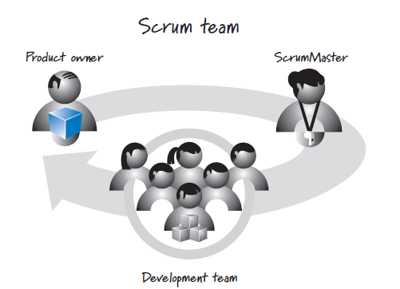
SCRUM Roles
Each Scrum team consists of three main roles.
There can be other roles but only these three are required.
Product Owner
Scrum Master
Development Team

Slide 3
Product Owner
Responsible for what will be developed and in what order
Central point of product leadership
Decides which features and functionality to build and in what order
Communicates the product vision to all participants
Responsible for overall development success
Must be available for questions and collaboration with other roles

Slide 4
Scrum Master
Responsible for guiding the team in creating and following processes
Helps participants understand Scrum values, principles, and practices
Acts as a coach and facilitator.
Resolves issues and makes improvements to Scrum processes
Assists with change management

Slide 5
Development Team
Responsible for determining how to deliver the product
Consists of a cross-functional group of resources (typically five to nine people)
Self-organized
Designs, builds, and tests the product

Slide 6
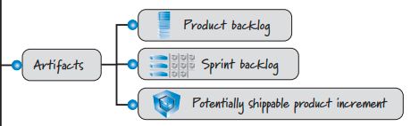
SCRUM Artifacts
The SCRUM Artifacts include the:
Product Backlog
Sprint Backlog
Sprint Results or Potentially shippable product increment
Image from: Essential Scrum: A Practical Guide to the Most Popular Agile Process by Kenneth Rubin Page 14 Chapter 2

Slide 7
Product Backlog
Product Backlog is a prioritized list the developer needs to complete a project.
Constantly changing due to:
To better fit the needs of the customer and stakeholders
Fix bugs within the product
Ideas that come along
Feedback

Slide 8
Sprint Backlog
Sprint Backlog is structured in detail of how the team plans to plan, build, design and test their product.
Short-term goals with the big picture in mind.

Slide 9
Sprint Results or Potentially Shippable Product Increment
Sprint Results or potentially shippable product increment. This is the Product Backlog items that have been completed during a sprint.
Ensures:
Flexibility
Transparency
Open for continuous improvement

Slide 10

SCRUM Activities
Sprint planning is a collaborative event in Scrum where the Scrum team plans the work they will perform during the upcoming sprint, which is a time-boxed iteration typically lasting one to four weeks.
During the sprint planning, the product owner discusses the prioritized product backlog items and the team determines the sprint goal selects the product backlog items they can commit to delivering within the sprint, this creates a plan for how to deliver the selected items. The output of the sprint planning meeting is the sprint goal and sprint backlog that identifies the tasks and backlog items that the team will work on during the sprint

Slide 11
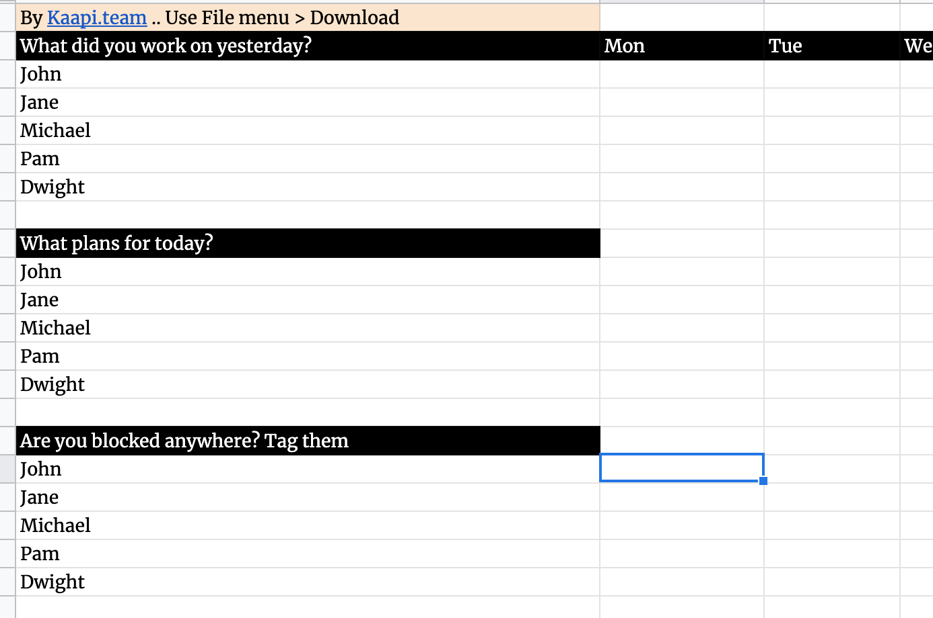
SCRUM Activities
A Daily Scrum, also known as a daily stand-up, is a brief, time-boxed event that occurs every day during a sprint in Scrum. The purpose of the daily scrum is for the development team to synchronize activities and create a plan for the next 24 hours. During the daily scrum, each team member answers three questions:
1. What did I accomplish yesterday?
2. What will I do today?
3. Are there any impediments or blockers in my way?
This is implied to make sure the team is efficient and focused.

Slide 12
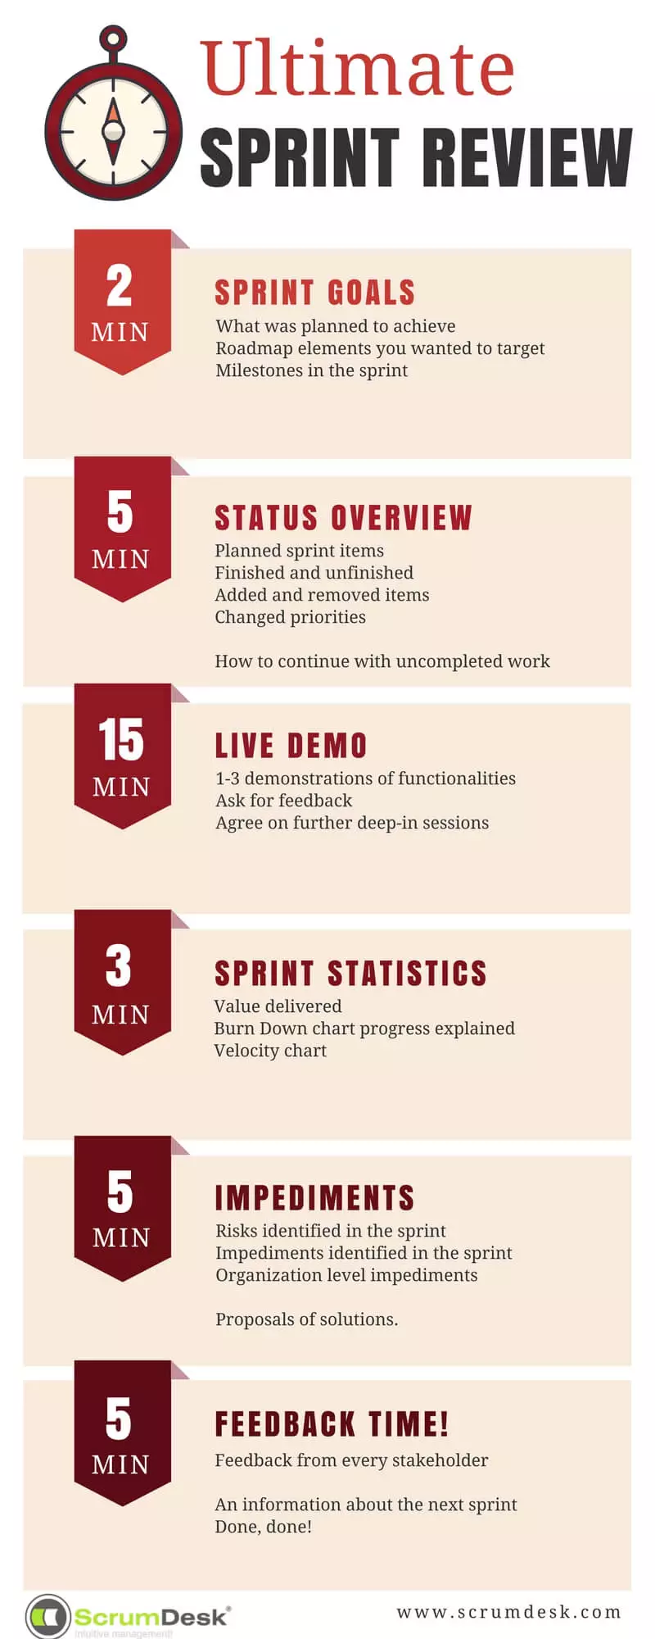
SCRUM Activities
During the Sprint Review, the Scrum team demonstrates the work they have completed and gathers feedback from stakeholders. The product owner discusses the product backlog and potential upcoming work. The entire group collaborates on what to do next, according to the feedback and the current state of the product backlog. The output of the sprint review is a revised product backlog that appropriately reflects the feedback and new learnings, and an updated plan for the next sprint. Ultimately The primary goal of the sprint review is to elicit feedback from stakeholders and review what was shipped during the sprint.

Slide 13
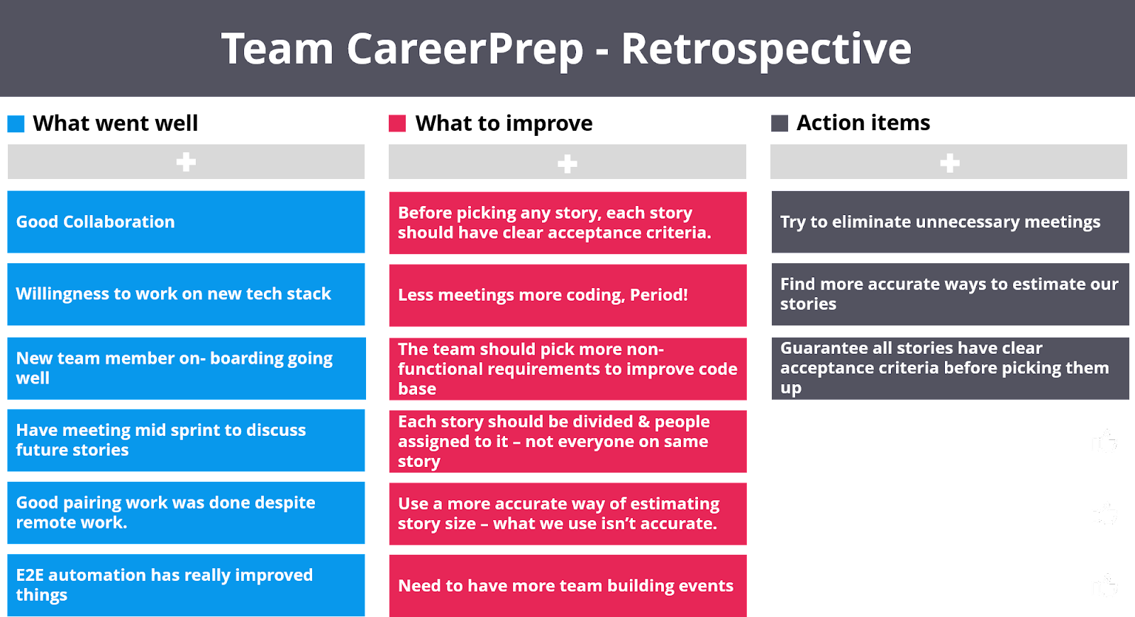
SCRUM Activities
During the Sprint Retrospective, the Scrum team reflects on the previous sprint, identifies and discusses what went well, what could be improved, and what actions can be taken in the next sprint to make improvements. The team comes together to discuss potential process improvements, address impediments, build a plan for implementing changes, and commit to process improvements to increase effectiveness and efficiency. With that being said The primary purpose of the sprint retrospective is for the Scrum team to inspect and adapt their processes and performance.

Slide 14
Supposed/Alleged Advantages of Scrum Principles
Variability and Uncertainty:
Embrace helpful variability.
Employ iterative and incremental development.
Leverage variability through inspection, adaptation, and transparency.
Reduce all forms of uncertainty simultaneously.

Slide 15
Supposed/Alleged Advantages of Scrum Principles
Prediction and Adaptation:
Keep options open
Accept that you can’t get it right up front.
Favor an adaptive, exploratory approach.
Embrace change in an economically sensible way.
Balance predictive up-front work with adaptive just-in-time work.

Slide 16
Supposed/Alleged Advantages of Scrum Principles
Validated Learning:
Validate important assumptions fast
Leverage multiple concurrent learning loops
Organize workflow for fast feedback.

Slide 17
Supposed/Alleged Advantages of Scrum Principles
Work in Process (WIP):
Economically Sensible Batch Sizes: This reduces the complexity and increases the output of tasks. Smaller batches facilitate quicker feedback and adjustments.
Managing Inventory for Good Flow: Helps in identifying bottlenecks and eliminating waste, ensuring a steady flow of work and resources.
Focusing on Idle Work, Not Idle Workers: Optimizes productivity by addressing work that is not moving forward, rather than pressuring workers who may be waiting on other tasks to be completed.
Considering Cost of Delay: Encourages prioritization of tasks based on their impact on the project timeline and cost, thus optimizing for value delivery.

Slide 18
Supposed/Alleged Advantages of Scrum Principles
Progress:
Adapting to Real-Time Information and Replan: This ensures that the project is always aligned with the latest information, and planning is iterative and responsive to changes.
Measuring Progress by Validating Working Assets: Concrete progress is measured by working features, not just completed tasks, which ensures that what is being built is actually delivering value.
Focusing on Value-Centric Delivery: This principle ensures that the team prioritizes work that delivers the most value to the customer, which can increase customer satisfaction and return on investment.

Slide 19
Supposed/Alleged Advantages of Scrum Principles
Performance:
Going Fast But Never Hurry: This philosophy ensures that the team works efficiently without sacrificing quality or making mistakes that would lead to delays.
Building in Quality: Quality is not a separate phase but is integrated into every step of the development process, reducing defects and rework.
Employing Minimally Sufficient Ceremony: This reduces unnecessary overhead, allowing the team to be more agile and responsive while still maintaining enough structure to ensure clarity and coordination.

Slide 20
Thank You!

